Slide 1
Travelling salesman problem
PRESENTED BY:-
RAJAT S U – ENG22AM0045
SHASHWATH DODAMANI-ENG22AM0058
SHRINIVAS SANJAY JOSHI-ENG22AM0062
PRUTHVIRAJ S R-ENG22AM0042
PRESENTED TO:-
Prof. Pradeep Kumar K
Dr. Mary Jasmine
Prof. Mitha Guru

Slide 2
Introduction :
The Traveling Salesman Problem (TSP) is a classic optimization problem in the field of computer science, operations research, and mathematics.
Given a set of cities and the distances between each pair of cities, the Traveling Salesman Problem involves finding the shortest possible route that visits each city exactly once and returns to the starting city. The objective is to minimize the total distance traveled by the salesman.

Slide 3
In more formal terms, let's denote:
n as the number of cities.
dij​ as the distance between city i and city j.
C as the set of all possible routes (permutations of cities).
The goal is to find a permutation P from C such that the sum of distances in the route is minimized:
Minimize∑(i,j) ∈ P ​dij​
The Traveling Salesman Problem is known to be an NP-hard problem, meaning that there is no known polynomial-time algorithm to solve it for all possible inputs. As a result, various heuristic and approximation algorithms are commonly used to find near-optimal solutions in a reasonable amount of time.
The TSP has numerous practical applications, especially in logistics, transportation planning, and circuit design. Solving the TSP efficiently is crucial in optimizing resource utilization and minimizing costs in real-world scenarios.

Slide 4
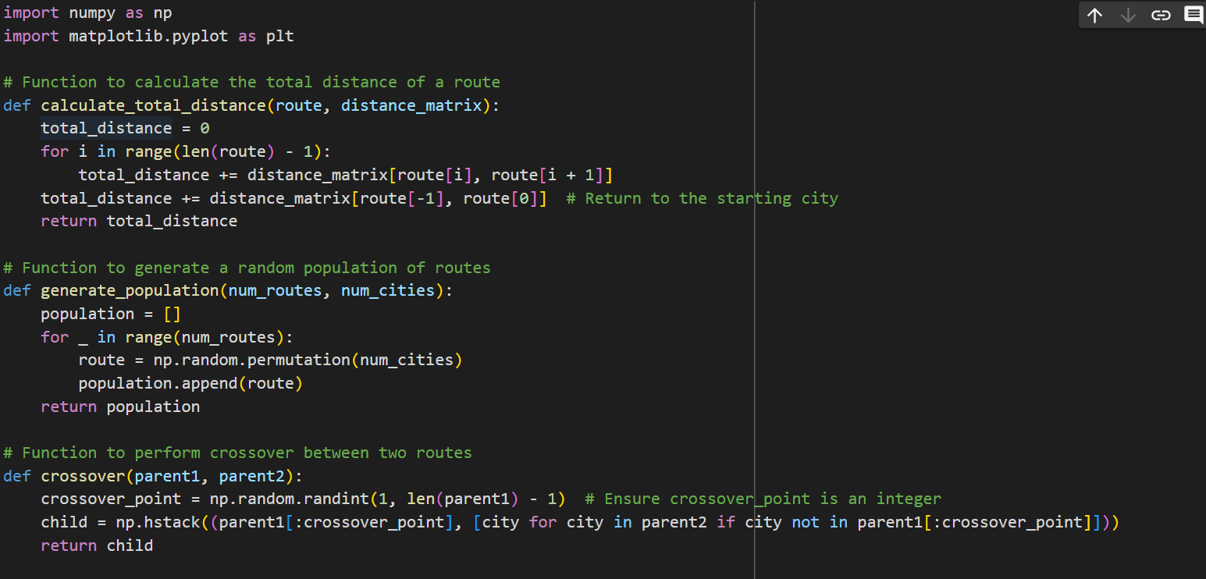
Code implementation

Slide 5
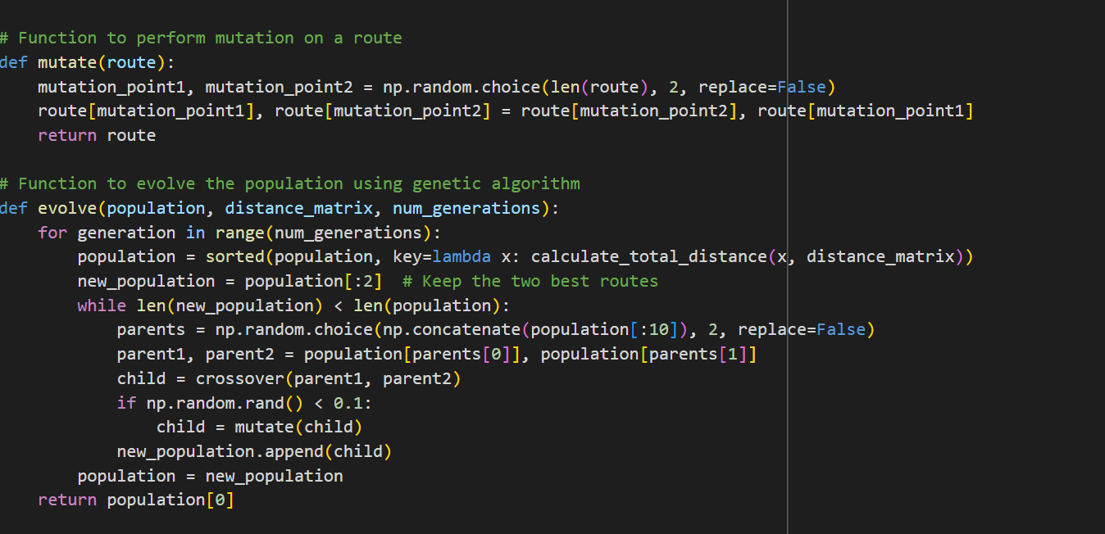

Slide 6
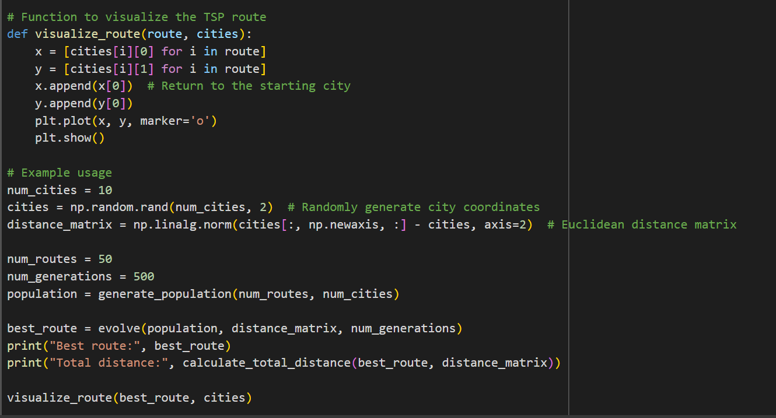

Slide 7

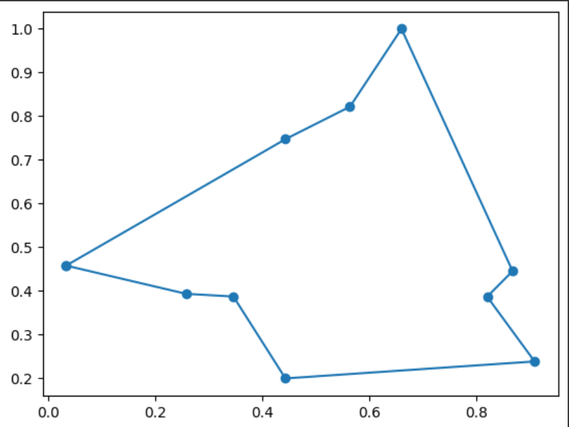
Output

Slide 8
Links and references
Example to show how a travelling salesman problem works :
https://tspvis.com/
Refercence for the code :
https://colab.research.google.com/drive/1_3TPKsb2tIQ9VEoDdfEckaUd3LRCV4aG?authuser=0

